Slide 1
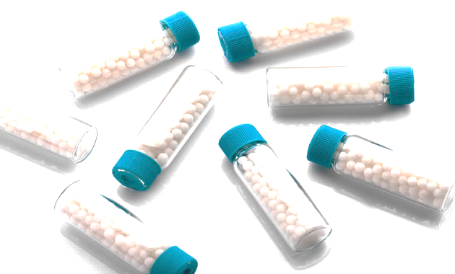
TATA 1mg Homeopathic
PREPARED BY :
DEBABRATA MOHANTY
SUDHANSHU SEKHAR PRADHAN
VAIBHAV DIXIT
MOHAMMAD ASRAF KHAN

Slide 2
TABLE OF CONTENTS
1.
Brief Introduction About the Company
3.
Aggregation on Different KPI’s
2.
Problem Statement
4.
DASHBOARD
3.
Our Approach Towards the Project
5.
INSIGHTS & Future Scope

Slide 3

BRIEF INTRODUCTION ABOUT THE COMPANY
Tata 1mg is India's leading mobile healthcare platform empowering Indian consumers and caregivers to select the most appropriate healthcare service at the best possible price.
Tata 1mg has played a pivotal role in making healthcare accessible, affordable and understandable to all.
The company enables consumers to learn more about their medicines in addition to finding more cost-effective substitutes.

Slide 4
PROBLEM-STATEMENT
Main aim is to analyze the data of 1mg Homeopathic and extract valuable insights that can help us understand the product offerings, pricing, brand specialization, user ratings, and ingredients used in homeopathic medicines.
These insights can be used to make informed decisions for opening a new homeopathic medicine store.

Slide 5
OUR APPROACH FOR THE PROJECT
WEB SCRAPPING – RETRIEVING DATA FROM 1MG WEBSITE
DATA CLEANING USING PYTHON & EXCEL
VISUALIZING & ANALYZING THE CLEAN DATA USING POWER BI
Reference:
https://www.1mg.com/
https://www.1mg.com/categories/homeopathy-57

Slide 6
Average price, min price , max price and Number of products for each brand.
Brand | Min of Price | Max of Price | Average of Price | No. of Products
Adel Pekana Germany | 492 | 492 | 492 | 20
Bakson's Homeopathy | 185 | 430 | 288 | 140
Bhargava Phytolab | 153 | 153 | 153 | 20
Bjain Pharmaceuticals Pvt Ltd | 47 | 314 | 161 | 180
Dr Batra Positive Health Products Limited | 139 | 557 | 348.25 | 80
Dr Reckeweg & Co | 160 | 267 | 226.13 | 160
Dr Willmar Schwabe India Pvt Ltd | 151 | 361 | 208.33 | 120
Fourrts India Laboratories Pvt Ltd | 90 | 90 | 90 | 20
HAPDCO | 151 | 151 | 151 | 20
SBL Pvt Ltd | 89 | 201 | 119.36 | 280

Slide 7
Number of medicine available for different benefit areas
Most number of Products i.e. 200 Products (Out of 1060 Listed Products) are Focused on curing Eye related Diseases While only 40 Products are focused on curing Depression.

Slide 8
Price Range of Different Brands
Bjain Pharmaceuticals Pvt Ltd is offering the cheapest Medicine whereas Dr Batra Positive Health Products Limited is offering the most Expensive Medicine .

Slide 9
Average Price range of medicine for each benefit area.
Price Range Varies from Rs.350.67 to Rs.99. Most Expensive Medicine cures Heart Diseases while least Expensive Medicine is for Ears.

Slide 10
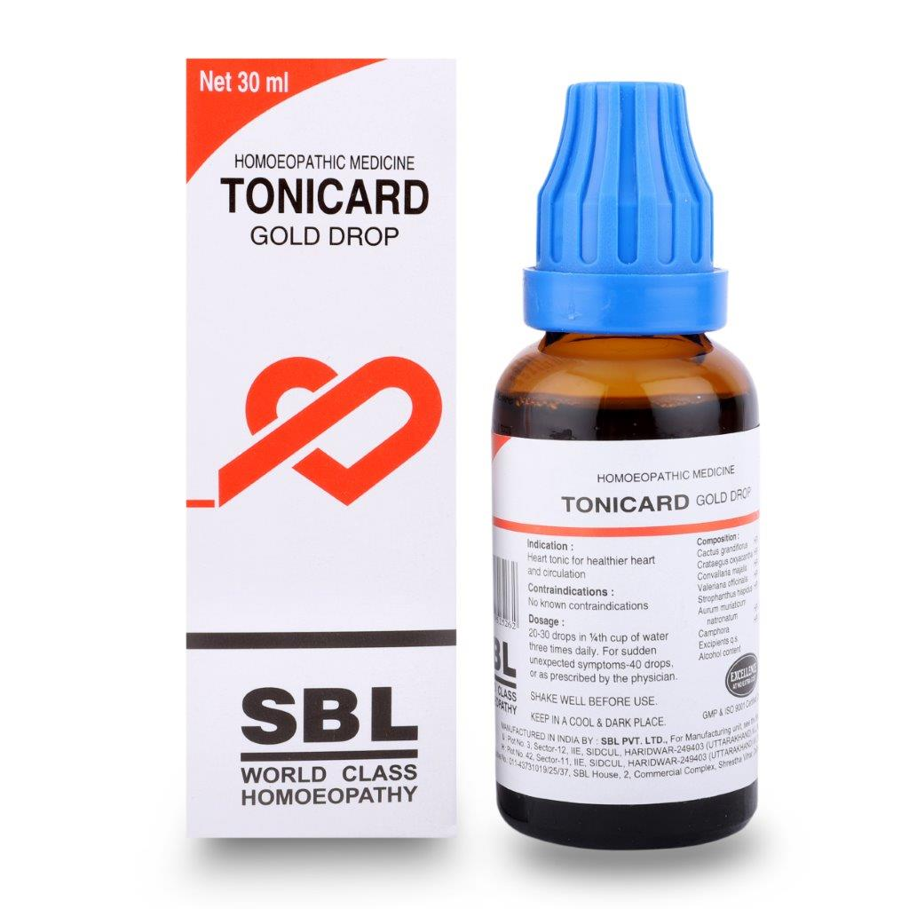
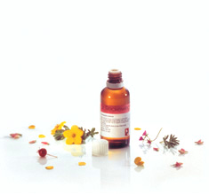
Brand specialization for each area (Key Benefits)
Dr. Bjain Pharmaceuticals Pvt Ltd, SBL Pvt Ltd and Dr Rechewg & Co. are the Brands which deals with the most 7 Benefit Areas.

Slide 11
Average number of rating for each brand in their specialization products.
Most People has Rated for SBL P Ltd. i.e. 2,17,744 Ratings , Which indicates SBL is most preferred Brand by the customers. Second Most Preferred Brand Dr. Reckeweg & Co lag by nearly 50% from SBL P Ltd.

Slide 12
Brands having most greater than 4 point review medicines.
Adel Pekana Germany, Bhargava Phytolab, Fourrts India Laboratories P Ltd are the top rated Brand with 4.6 Stars out of 5 star .

Slide 13
Most used ingredient
Ferrum phosphoricum & Calcarea Phos is used in Nearly 30% of the Products. And Aesculus Hippocastanum,Semen Et Pollen,Thuja is used in almost 23% of the Products.

Slide 14
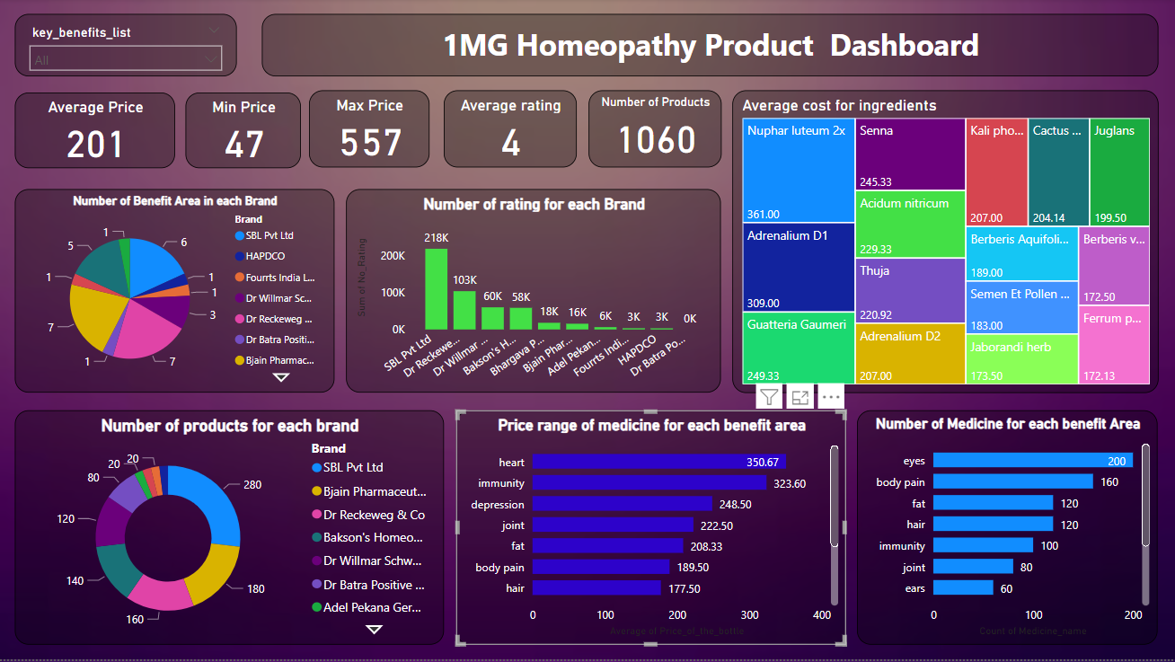

Slide 15
INSIGHTS
We are having a total of 1060 listed Homeopathic Products in our 1Mg Website, having an Average Price of Rs. 201.
The Price Range varies widely with a MIN Price of Rs.47 And MAX Price of Rs. 557.
Top Three brands in the homeopathic medicine space based on ratings are SBL, Dr. Reckeweg, and Schwabe.
Dr.Reckeweg is the brand with the most-high rated products ,with more than 40 products rated above 4 star.
The most expensive brand of homeopathic medicines is Dr. Reckeweg, while the cheapest brand is Baksons.
Nuphar letumen 2x is the most expensive ingredient and if there is a substitute of this then we can use that to reduce the cost of the medicine.
Most common benefit areas for homeopathic medicines are joint pain, hair care, skin care, and eye care.
The most commonly used ingredient in homeopathic medicines is Arnica Montana, which is found in many Joint pain medicines.

Slide 16
Future Scope
Success of antibiotics in conquering bacterial infections, viral infections may become more prevalent in the future. Homeopathy has shown promise in treating viral infections and may be a valuable option in the years to come as we already seen during covid19.
Homeopathy has helped secondary infertility in high numbers.
Incorporating technology and expanding into new markets may also be important for staying competitive and reaching new customers.
1mg Homeopathic could explore expanding into new geographic markets or increasing their reach within existing markets. This could involve partnerships with local providers, marketing campaigns targeted towards specific demographics, or offering new services to attract new customers.

Slide 17
THANK YOU

